Slide 1
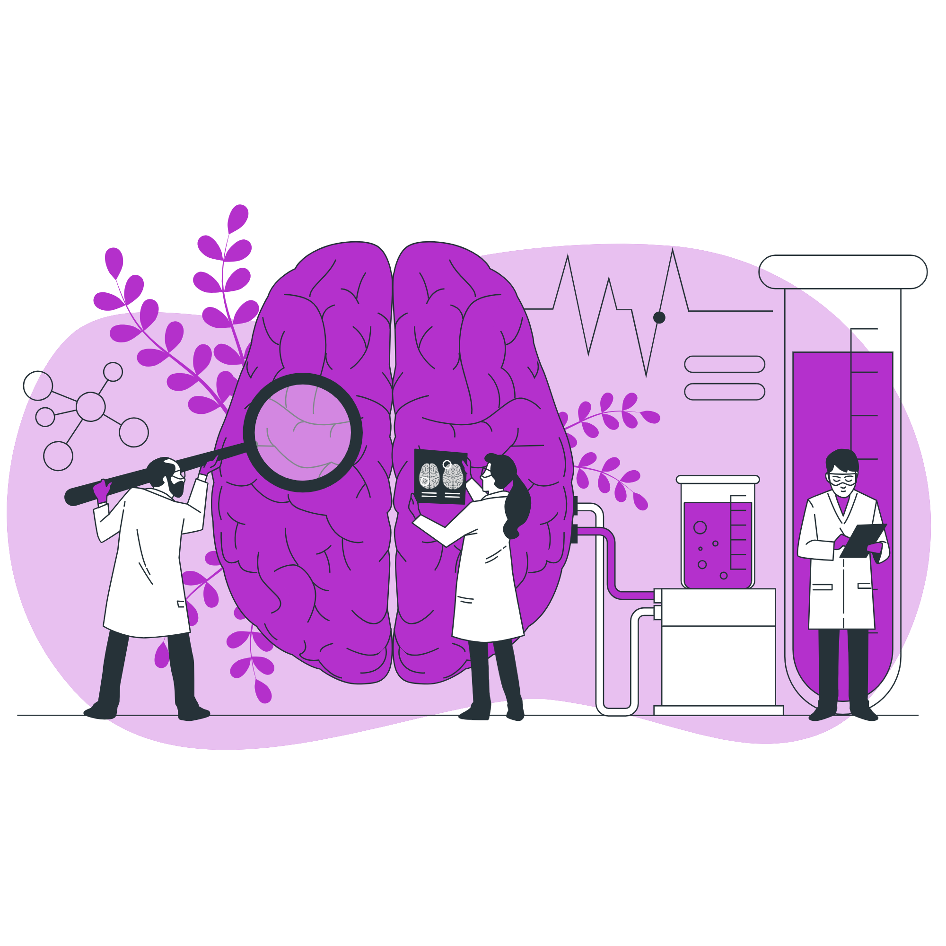
MindScan: Intelligent Brain MRI Analysis for Tumor Detection
Presented By:
ABOUHANE Zahra
BAZGOUR Yassine
Supervised By:
Dr. Issam Qaffou
https://www.flaticon.com/search?word=data

Slide 2
Problematic
01

Slide 3
248,403
Deaths from brain and central nervous system (CNS) cancers worldwide (2022)
https://pubmed.ncbi.nlm.nih.gov/40720078/

Slide 4
Aim
02

Slide 5
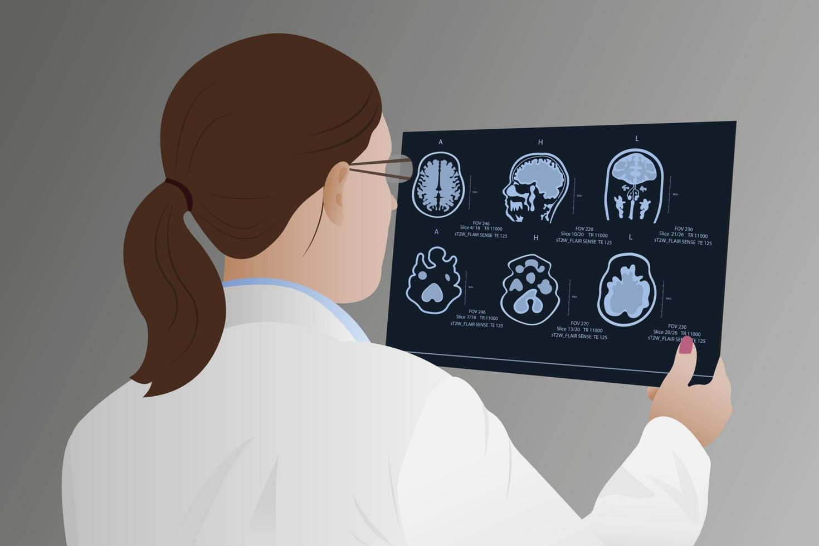
TUMOR DETECTION SYSTEM

Slide 6
Data
03

Slide 7
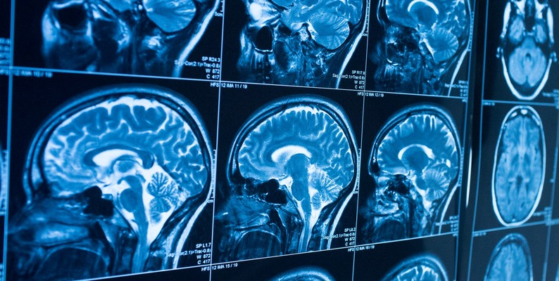
Brain Tumor MRI Dataset.

Slide 8
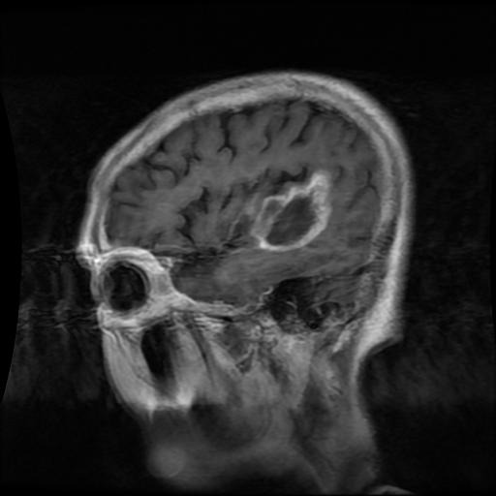
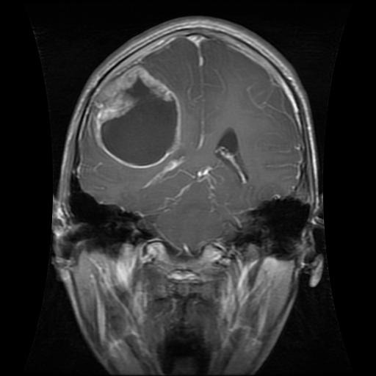
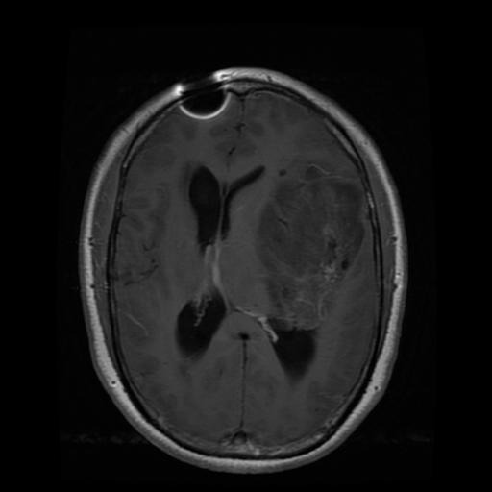
Samples From The Dataset

Slide 9
7,023 images
4 diagnostic categories | 1 Normal | 3 Abnormal
Image Modality: T1-weighted contrast-enhanced MRI scans
High-resolution images
Class imbalance with abnormal as majority class
Labels confirmed by expert radiologists and pathologists to ensure diagnostic accuracy

Slide 10
Plots about the data

Slide 11


Binary Skin Classifier Data
Multi Skin Classifier Data
Before: NUM Classes
Abnormal Classes: NUM Images
Normal Classes: NUM Images
After: NUM Classes
Abnormal Class: NUM Images
Normal Class: NUM Images
Before: NUM Classes
Abnormal Classes: NUM Images
Normal Classes: 8061 Images
After: NUM Classes
mel: NUM Images
bcc: NUM Images
akiec: NUM Images

Slide 12
Model
04

Slide 13
EfficientNetV2B0
India 2025
https://ieeexplore.ieee.org/abstract/document/10912377
Accuracy: 96% | Recall: 100%
India 2024
https://ieeexplore.ieee.org/abstract/document/10533983
Accuracy: 98% (ISIC) 99% (HAM)
Saudi Arabia 2022
Accuracy: 99% (Detection) Accuracy: 99% (Classification)
https://www.mdpi.com/2072-6694/14/23/5872

Slide 14
EfficientNetV2B0
Input Size: 224 × 224 × 3
Parameters: 7,184,897
Size: 7,184,897 (parameter) x 4 (byte) = 27.4 (Mb)
FLOPs: ~0.98B
Depth: 237 layers
Training Speed: Faster than EfficientNetV1 due to fused MBConv blocks

Slide 15
Pipeline
05

Slide 16





Multi
Classification
Data
Multi
Classification
Model
Preprocessed
Data
Preprocess
Data
Model Choice &
Training & Evaluation
Scouting &
Splitting
Raw
Data
Model Choice &
Training &
Evaluation
Preprocess
Data
Binary
Classification
Data
Preprocessed
Data
Binary
Classification
Model

Slide 17
Interface
06

Slide 18




Technologies Used
HTML
Javascript
CSS
Python
Backend
Frontend

Slide 19
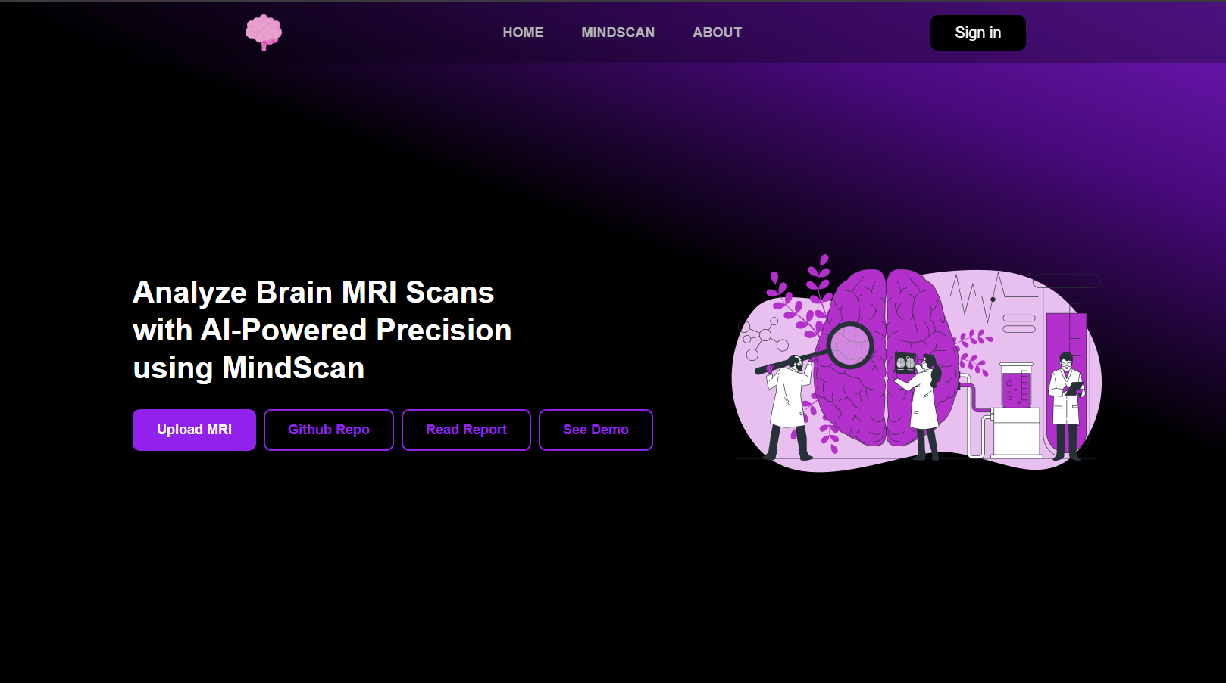

Slide 20
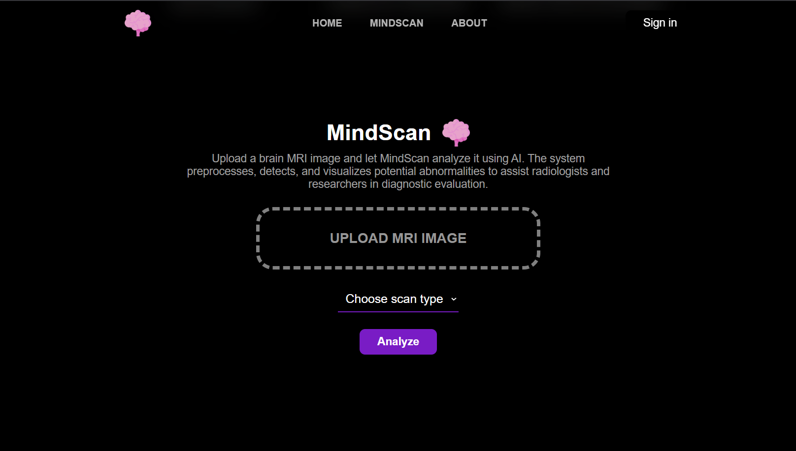

Slide 21




Prediction &
Confidence
If Normal
MRI
Medical
Image
Preprocess
Data
User
Interface
Binary
Classification
Model
Tumor
Type
If Abnormal
Multi
Classification
Model
Tumor Type &
Confidence

Slide 22
Results
07

Slide 23
training results

Slide 24
interface results

Slide 25
Demo
08

Slide 26
Discussion
09

Slide 27



Benefits
Early Tumor Detection
Accessible to Everyone Through Mobiles
Multi-Input Learning

Slide 28


Limitations
Lack of Clinical Validation
Poor Generalization

Slide 29
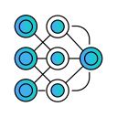

Future Work
Test Other Pretrained Models
Enlarge Dataset and Improve its Quality

Slide 30

Thank You

